Slide 1
Variable Environments II
Competition in variable environments

Slide 2
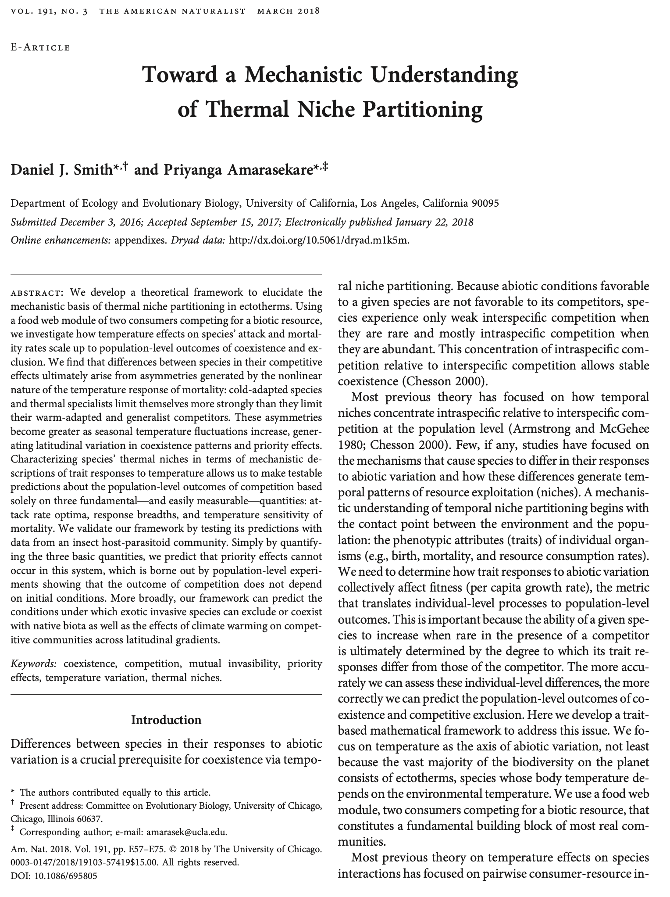
Next time…

Slide 3
Competitive exclusion principle
CEP v1.0: No more species can coexist than limiting resources

Slide 6
Competitive exclusion principle
CEP v1.0: No more species can coexist than limiting resources
CEP v2.0: No more species can coexist than limiting resources at equilibrium (Armstrong & McGehee 1980 Am Nat)

Slide 7
Making Hutchinson’s argument rigorous
Two ways temporal variation can allow species coexistence
Relative nonlinearity
Growth rate at high vs low resources
Storage effect
Superior competitor depends on environmental factor that fluctuates
(Chesson 1994, 2000)

Slide 8
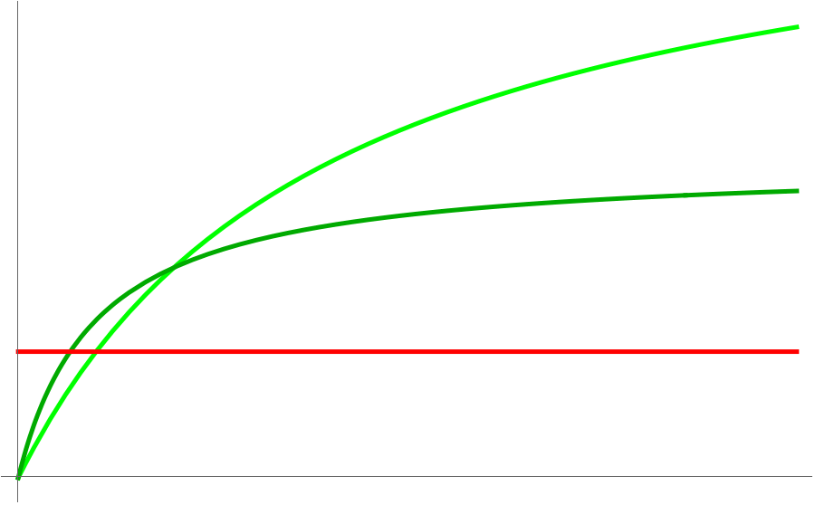
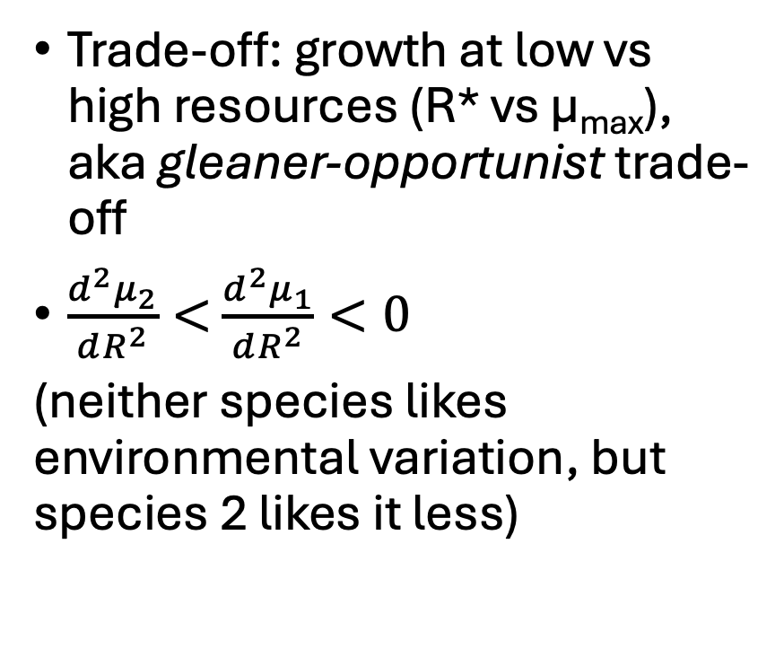
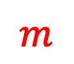
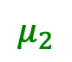
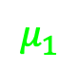
Relative nonlinearity
Trade-off: growth at low vs high resources (R* vs µ_{max}), aka gleaner-opportunist trade-off
$\frac{d^{2}μ_{2}}{dR^{2}}<$ $\frac{d^{2}μ_{1}}{dR^{2}}<0$
(neither species likes environmental variation, but species 2 likes it less)
$$μ_{1}$$
$$μ_{2}$$
$$m$$
resource, R

Slide 9
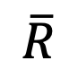
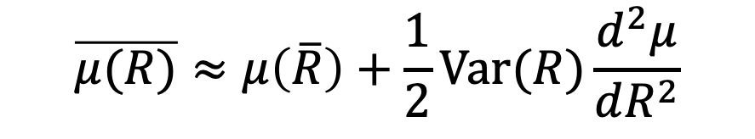
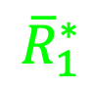
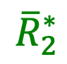
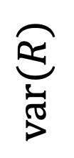
Variance as a resource 🤯
$$\text{var}(R)$$
$$\overline{μ(R)}≈μ\left(\overline{R}\right)+\frac{1}{2}\text{Var}(R)\frac{d^{2}μ}{dR^{2}}$$
•
$${\overline{R}}_{2}^{∗}$$
$${\overline{R}}_{1}^{∗}$$
$$\overline{R}$$
(Levins 1979)

Slide 10


Variance as a resource 🤯
Opportunist must “consume” var(R) more than gleaner for stable coexistence
$$\text{var}(R)$$
•
$${\overline{R}}_{2}^{∗}$$
$${\overline{R}}_{1}^{∗}$$
$$\overline{R}$$
(Yamamichi & Letten 2022 J Anim Ecol)

Slide 11
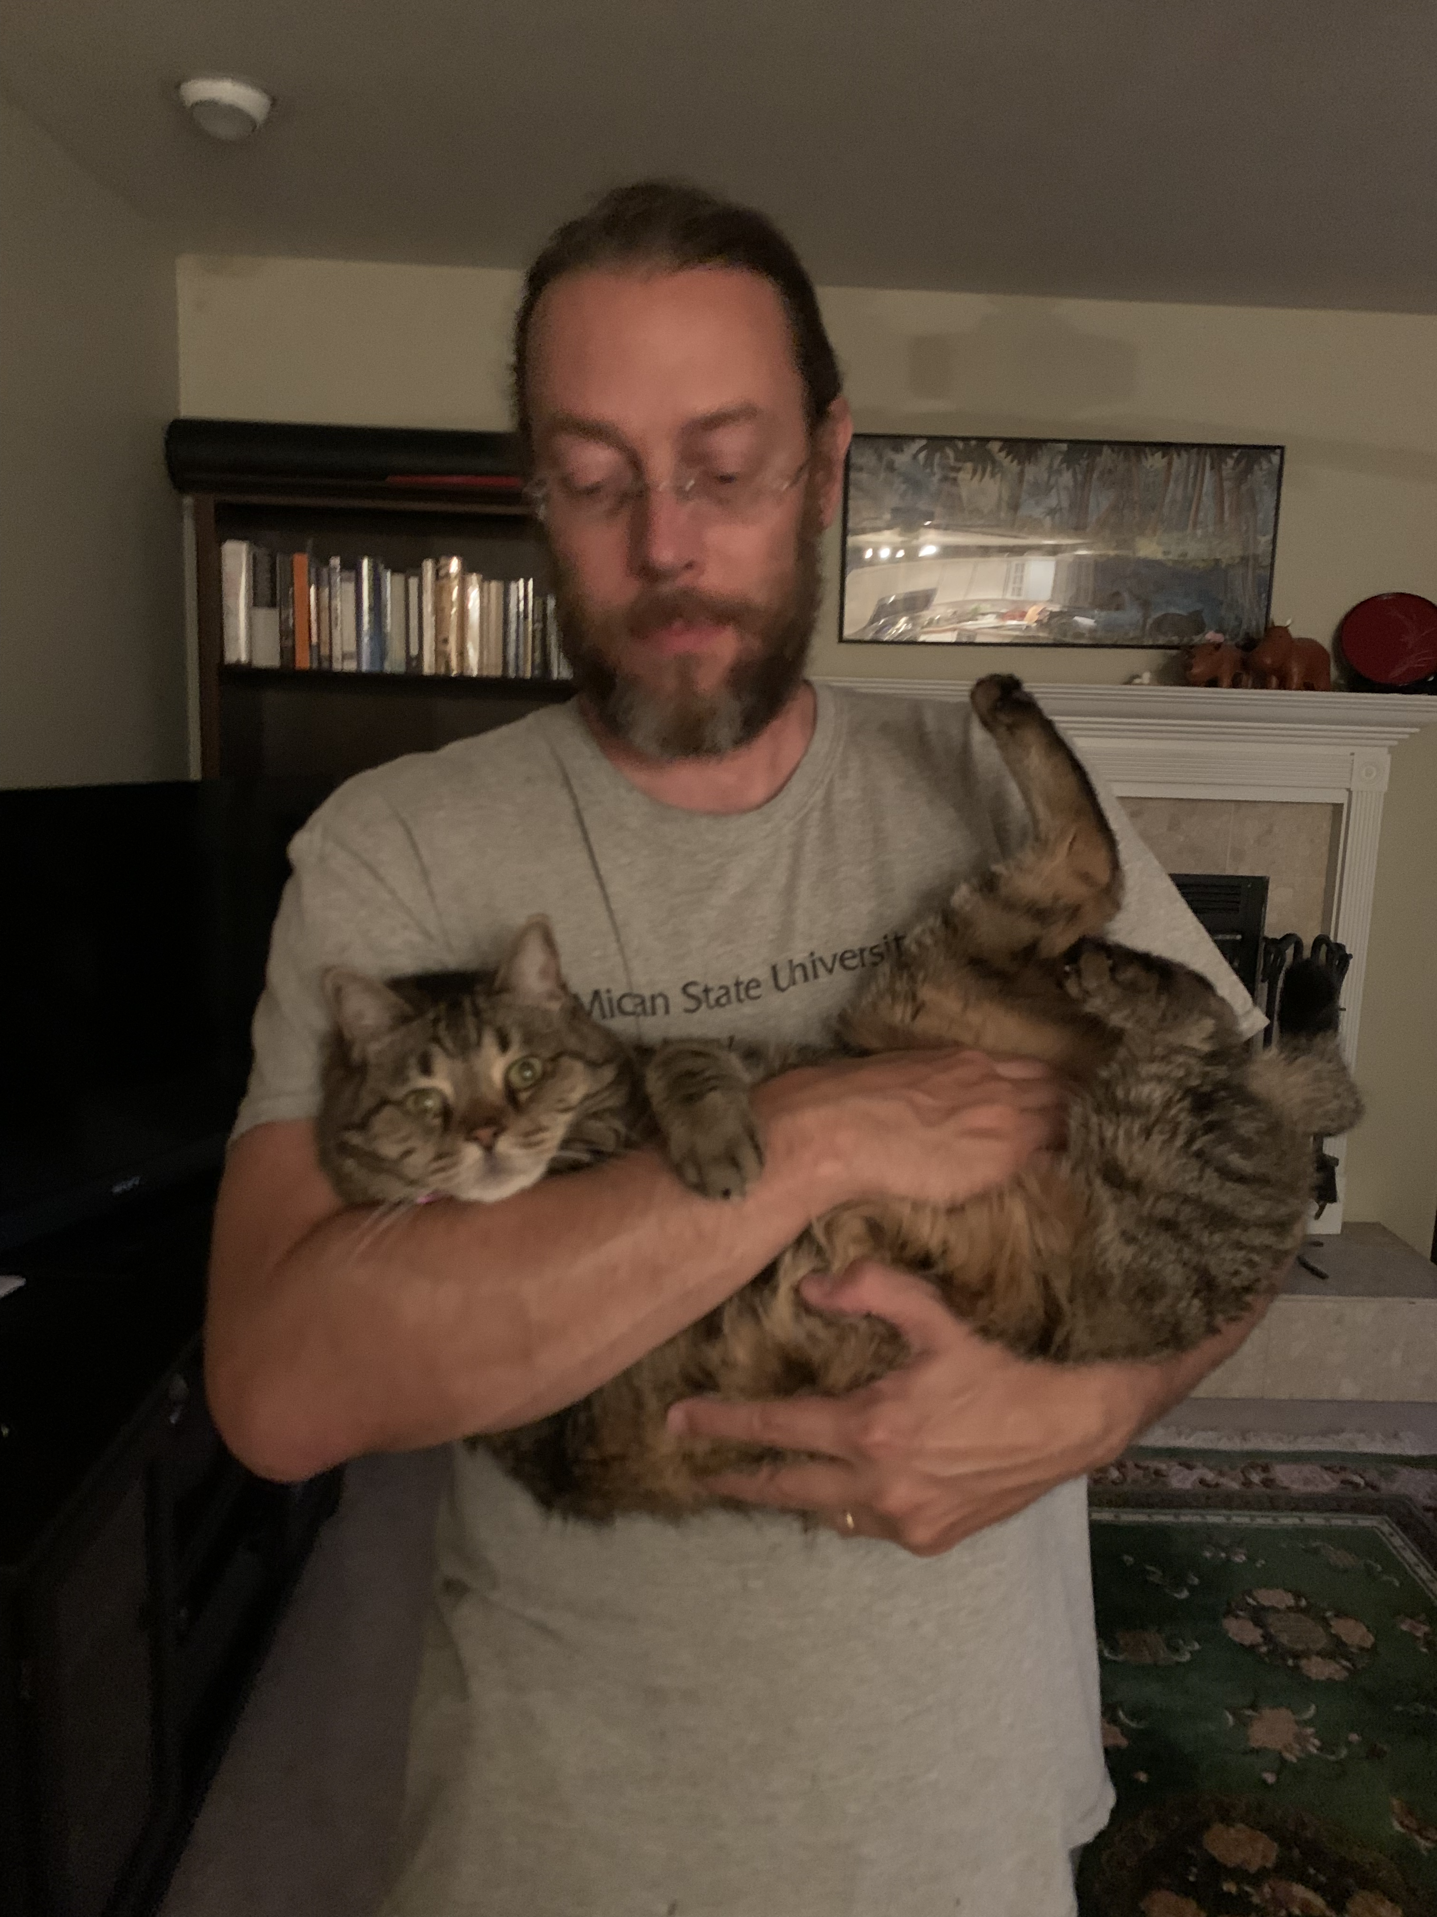
Ex: Alternating growth & death
yes
Growth?
no
0
Φ 𝜏
𝜏
time
𝜏 – period
Φ – growing proportion
(Litchman & Klausmeier 2001 Am Nat, Kremer & Klausmeier 2013 JTB)

Slide 12

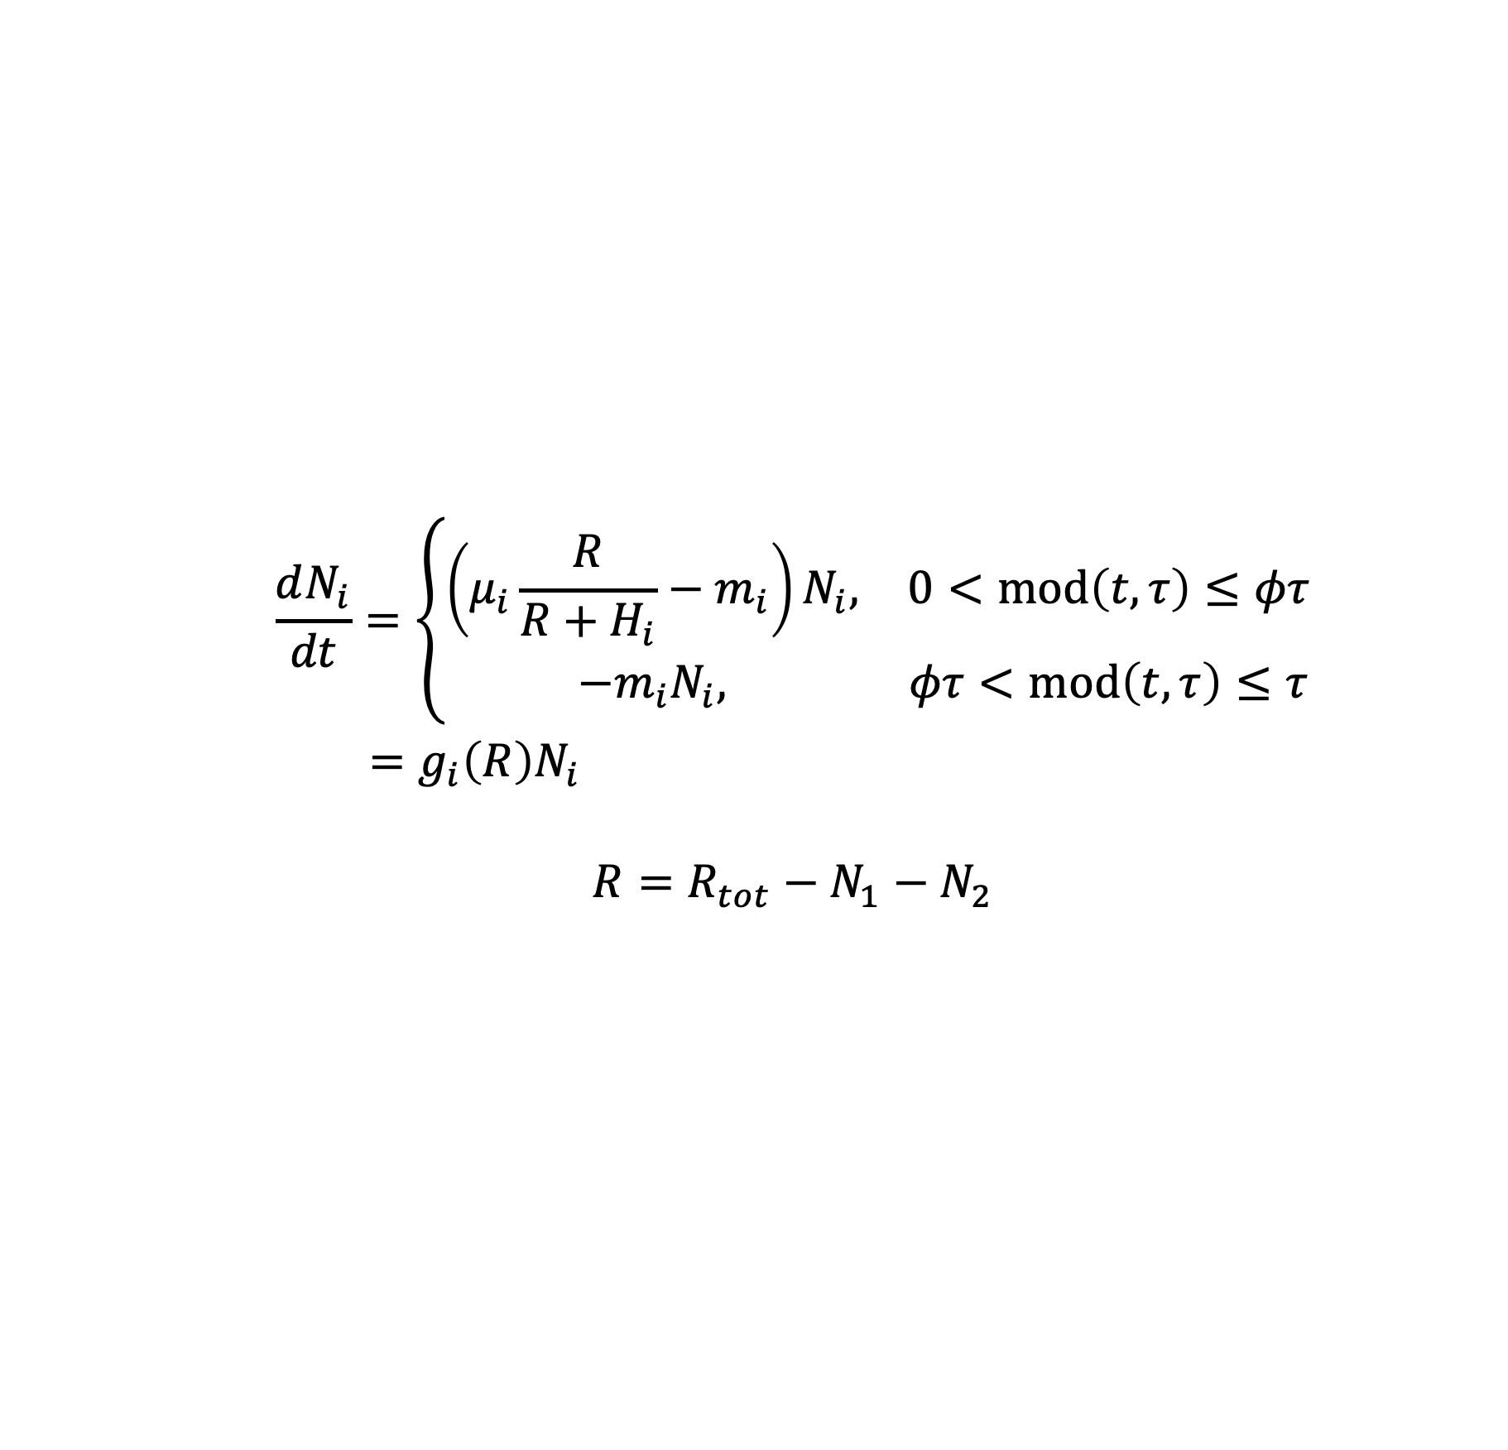
Ex: Alternating growth & death
$$\frac{dN_{i}}{dt}=\left\{\begin{matrix}\left(μ_{i}\frac{R}{R+H_{i}}−m_{i}\right)N_{i}, & 0<\text{mod}\left(t,τ\right)≤φτ \\ −m_{i}N_{i}, & φτ<\text{mod}\left(t,τ\right)≤τ\end{matrix}\right.$$
$=g_{i}\left(R\right)N_{i}$
$$R=R_{tot}−N_{1}−N_{2}$$
(Litchman & Klausmeier 2001 Am Nat, Kremer & Klausmeier 2013 JTB)

Slide 13
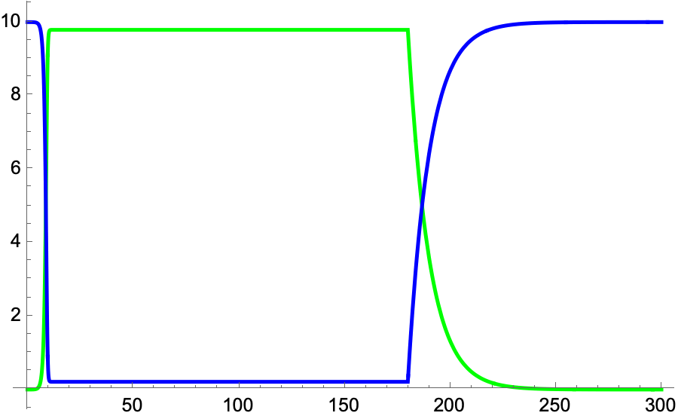
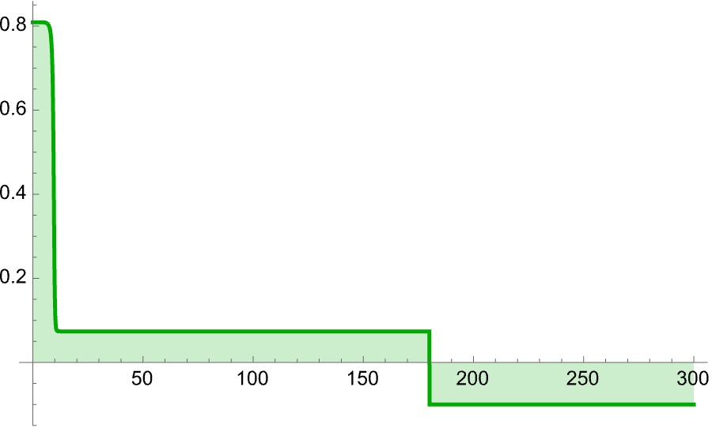
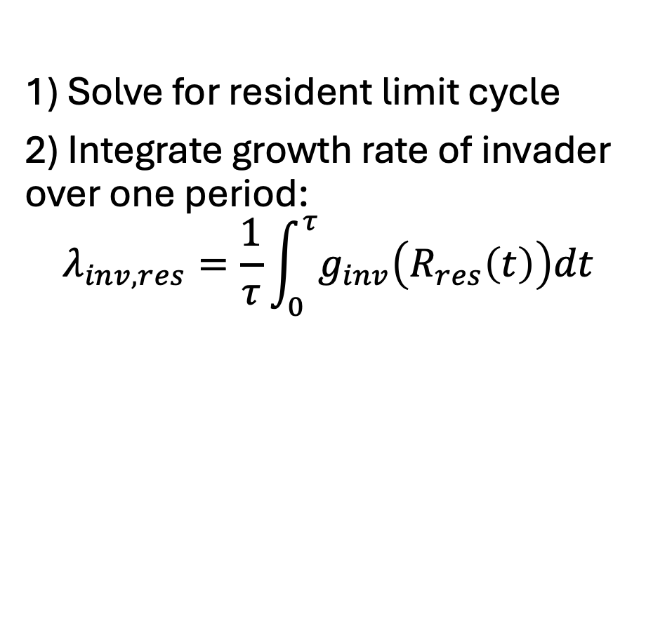
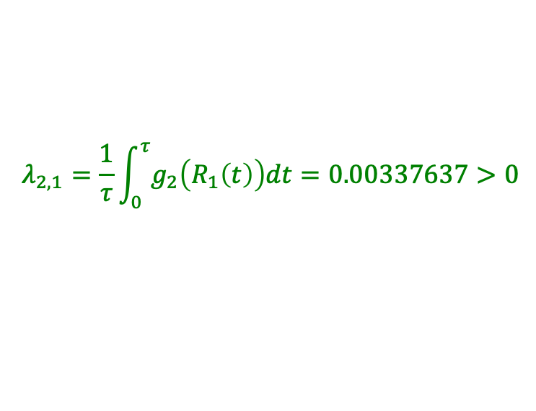
Invasion analysis in periodic models
R
N₁
1) Solve for resident limit cycle
2) Integrate growth rate of invader over one period:
$$λ_{inv,res}=\frac{1}{τ}\int_{0}^{τ}{g_{inv}\left(R_{res}\left(t\right)\right)dt}$$
g₂
$$λ_{2,1}=\frac{1}{τ}\int_{0}^{τ}{g_{2}\left(R_{1}\left(t\right)\right)dt=0.00337637>0}$$
(Litchman & Klausmeier 2001 Am Nat, Kremer & Klausmeier 2013 JTB)

Slide 14
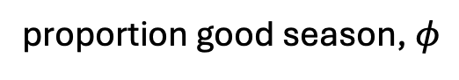
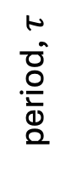
Ex: Alternating growth & death
period, $τ$
proportion good season, $φ$
(Litchman & Klausmeier 2001 Am Nat)

Slide 15
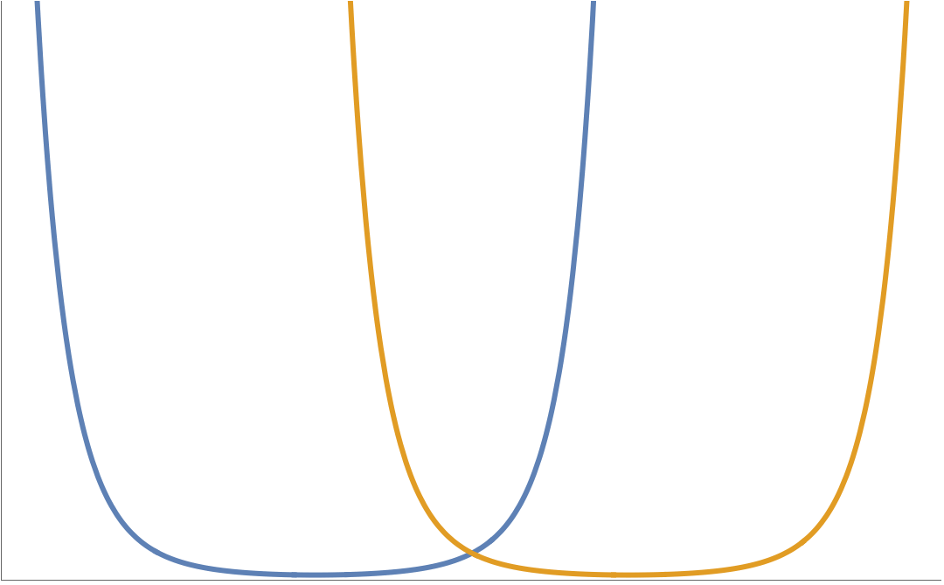
Storage effect
Varying environmental factor causes identity of superior competitor to switch (as in Hutchinson’s explanation)
1 wins
2 wins
1
2
R*
Environment, E

Slide 16
Ex: Sinusoidally varying temperature
(Kremer & Klausmeier 2017)

Slide 17
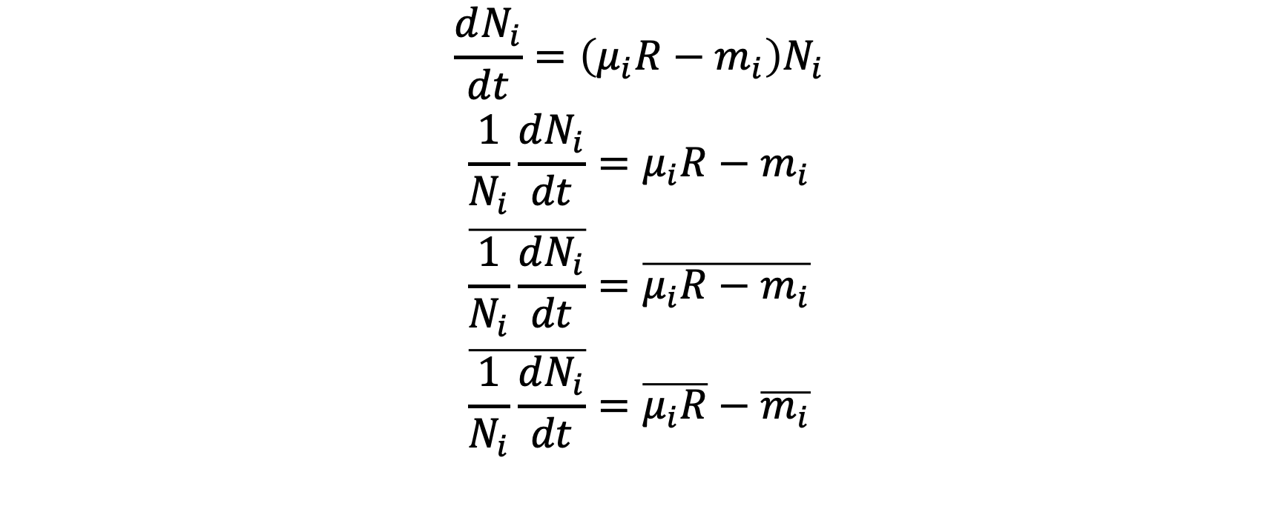
Storage effect analysis
$$\frac{dN_{i}}{dt}=\left(μ_{i}R−m_{i}\right)N_{i}$$
$$\frac{1}{N_{i}}\frac{dN_{i}}{dt}=μ_{i}R−m_{i}$$
$$\overline{\frac{1}{N_{i}}\frac{dN_{i}}{dt}}=\overline{μ_{i}R−m_{i}}$$
$$\overline{\frac{1}{N_{i}}\frac{dN_{i}}{dt}}=\overline{μ_{i}R}−\overline{m_{i}}$$

Slide 18
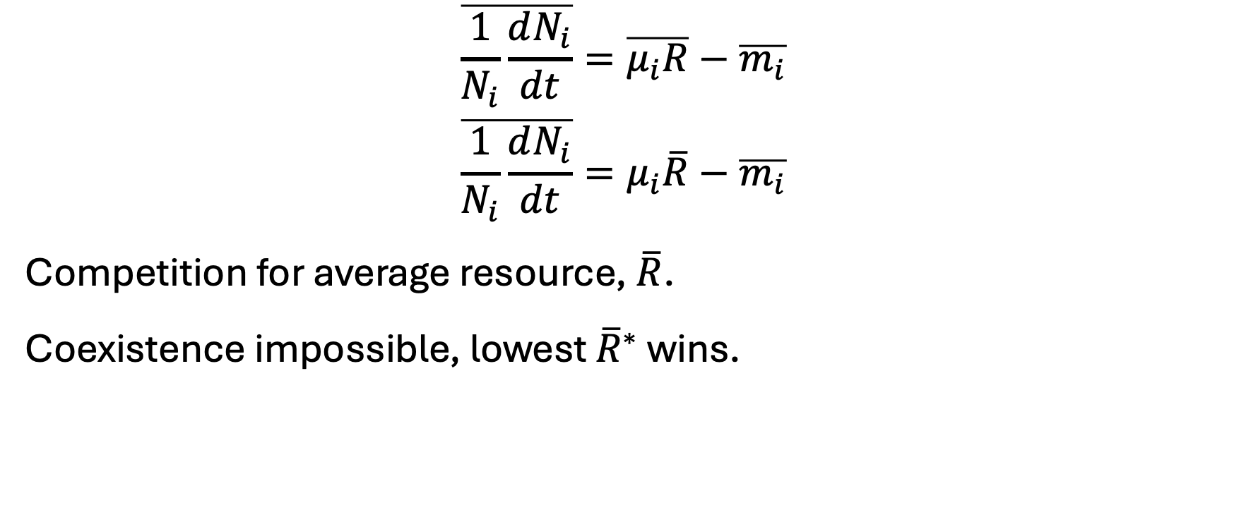
Temporal variation only in m
$$\overline{\frac{1}{N_{i}}\frac{dN_{i}}{dt}}=\overline{μ_{i}R}−\overline{m_{i}}$$
$$\overline{\frac{1}{N_{i}}\frac{dN_{i}}{dt}}=μ_{i}\overline{R}−\overline{m_{i}}$$
Competition for average resource, $\overline{R}$.
Coexistence impossible, lowest ${\overline{R}}^{∗}$ wins.

Slide 19
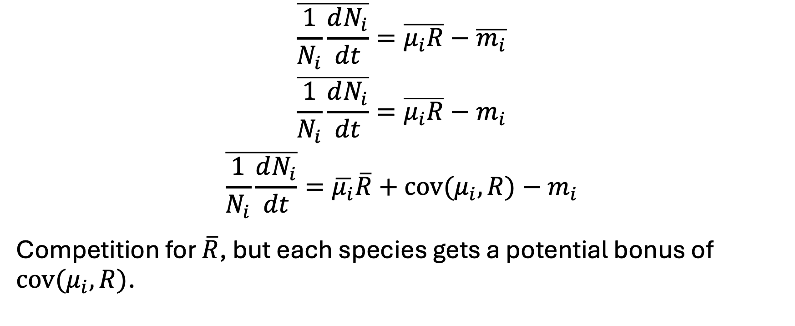
Temporal variation only in µ
$$\overline{\frac{1}{N_{i}}\frac{dN_{i}}{dt}}=\overline{μ_{i}R}−\overline{m_{i}}$$
$$\overline{\frac{1}{N_{i}}\frac{dN_{i}}{dt}}=\overline{μ_{i}R}−m_{i}$$
$$\overline{\frac{1}{N_{i}}\frac{dN_{i}}{dt}}=\overline{μ_{i}}\overline{R}+\text{cov}(μ_{i},R)−m_{i}$$
Competition for $\overline{R}$, but each species gets a potential bonus of $\text{cov}(μ_{i},R)$.
(Fox 2013, Miller & Klausmeier 2017)

Slide 20
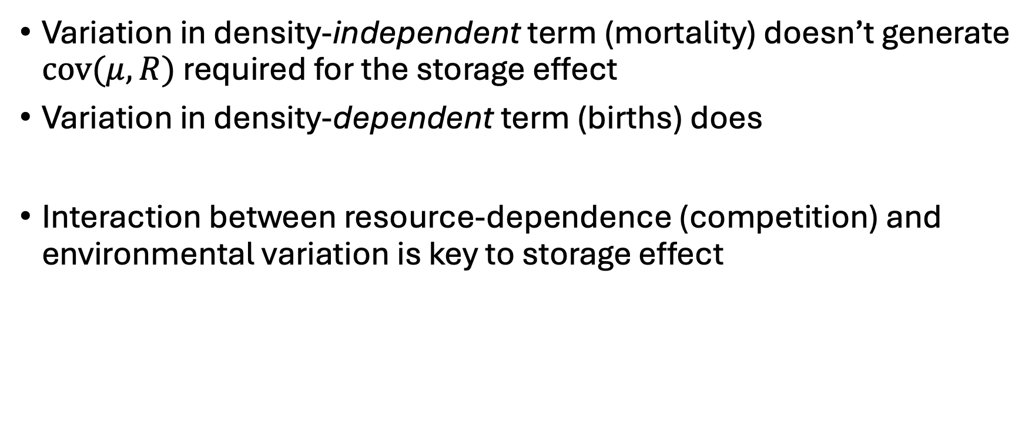
What’s the difference?
Variation in density-independent term (mortality) doesn’t generate $\text{cov}(μ,R)$ required for the storage effect
Variation in density-dependent term (births) does
Interaction between resource-dependence (competition) and environmental variation is key to storage effect
(Chesson 1994, Fox 2013)

Slide 21
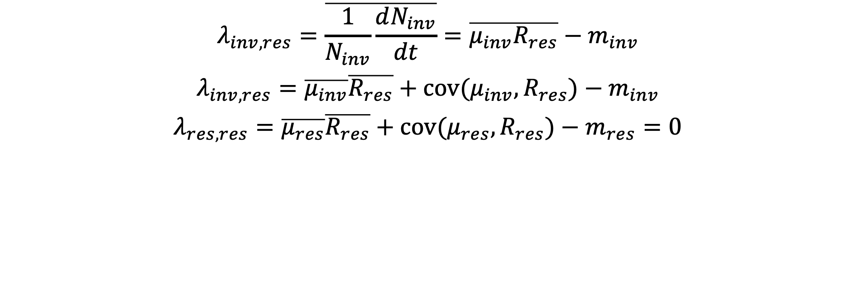
Decomposing invasion rates
$$λ_{inv,res}=\overline{\frac{1}{N_{inv}}\frac{dN_{inv}}{dt}}=\overline{μ_{inv}R_{res}}−m_{inv}$$
$$λ_{inv,res}=\overline{μ_{inv}}\overline{R_{res}}+\text{cov}(μ_{inv},R_{res})−m_{inv}$$
$$λ_{res,res}=\overline{μ_{res}}\overline{R_{res}}+\text{cov}(μ_{res},R_{res})−m_{res}=0$$
(Chesson 1994, Miller & Klausmeier 2017)

Slide 22
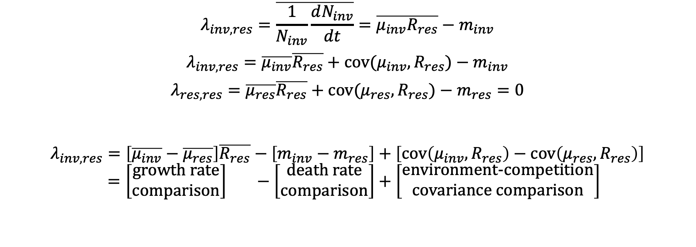
Decomposing invasion rates
$$λ_{inv,res}=\overline{\frac{1}{N_{inv}}\frac{dN_{inv}}{dt}}=\overline{μ_{inv}R_{res}}−m_{inv}$$
$$λ_{inv,res}=\overline{μ_{inv}}\overline{R_{res}}+\text{cov}(μ_{inv},R_{res})−m_{inv}$$
$$λ_{res,res}=\overline{μ_{res}}\overline{R_{res}}+\text{cov}(μ_{res},R_{res})−m_{res}=0$$
$$λ_{inv,res}=\left[\overline{μ_{inv}}−\overline{μ_{res}}\right]\overline{R_{res}}−\left[m_{inv}−m_{res}\right]+\left[\text{cov}\left(μ_{inv},R_{res}\right)−\text{cov}\left(μ_{res},R_{res}\right)\right] \\ =\left[\begin{matrix}\text{growth} \text{rate} \\ \text{comparison}\end{matrix}\right] −\left[\begin{matrix}death \text{rate} \\ \text{comparison}\end{matrix}\right]+\left[\begin{matrix}\text{environment}\text{-}\text{competition} \\ \text{covariance} \text{comparison}\end{matrix}\right]$$
(Chesson 1994, Miller & Klausmeier 2017)

Slide 23


Slide 24
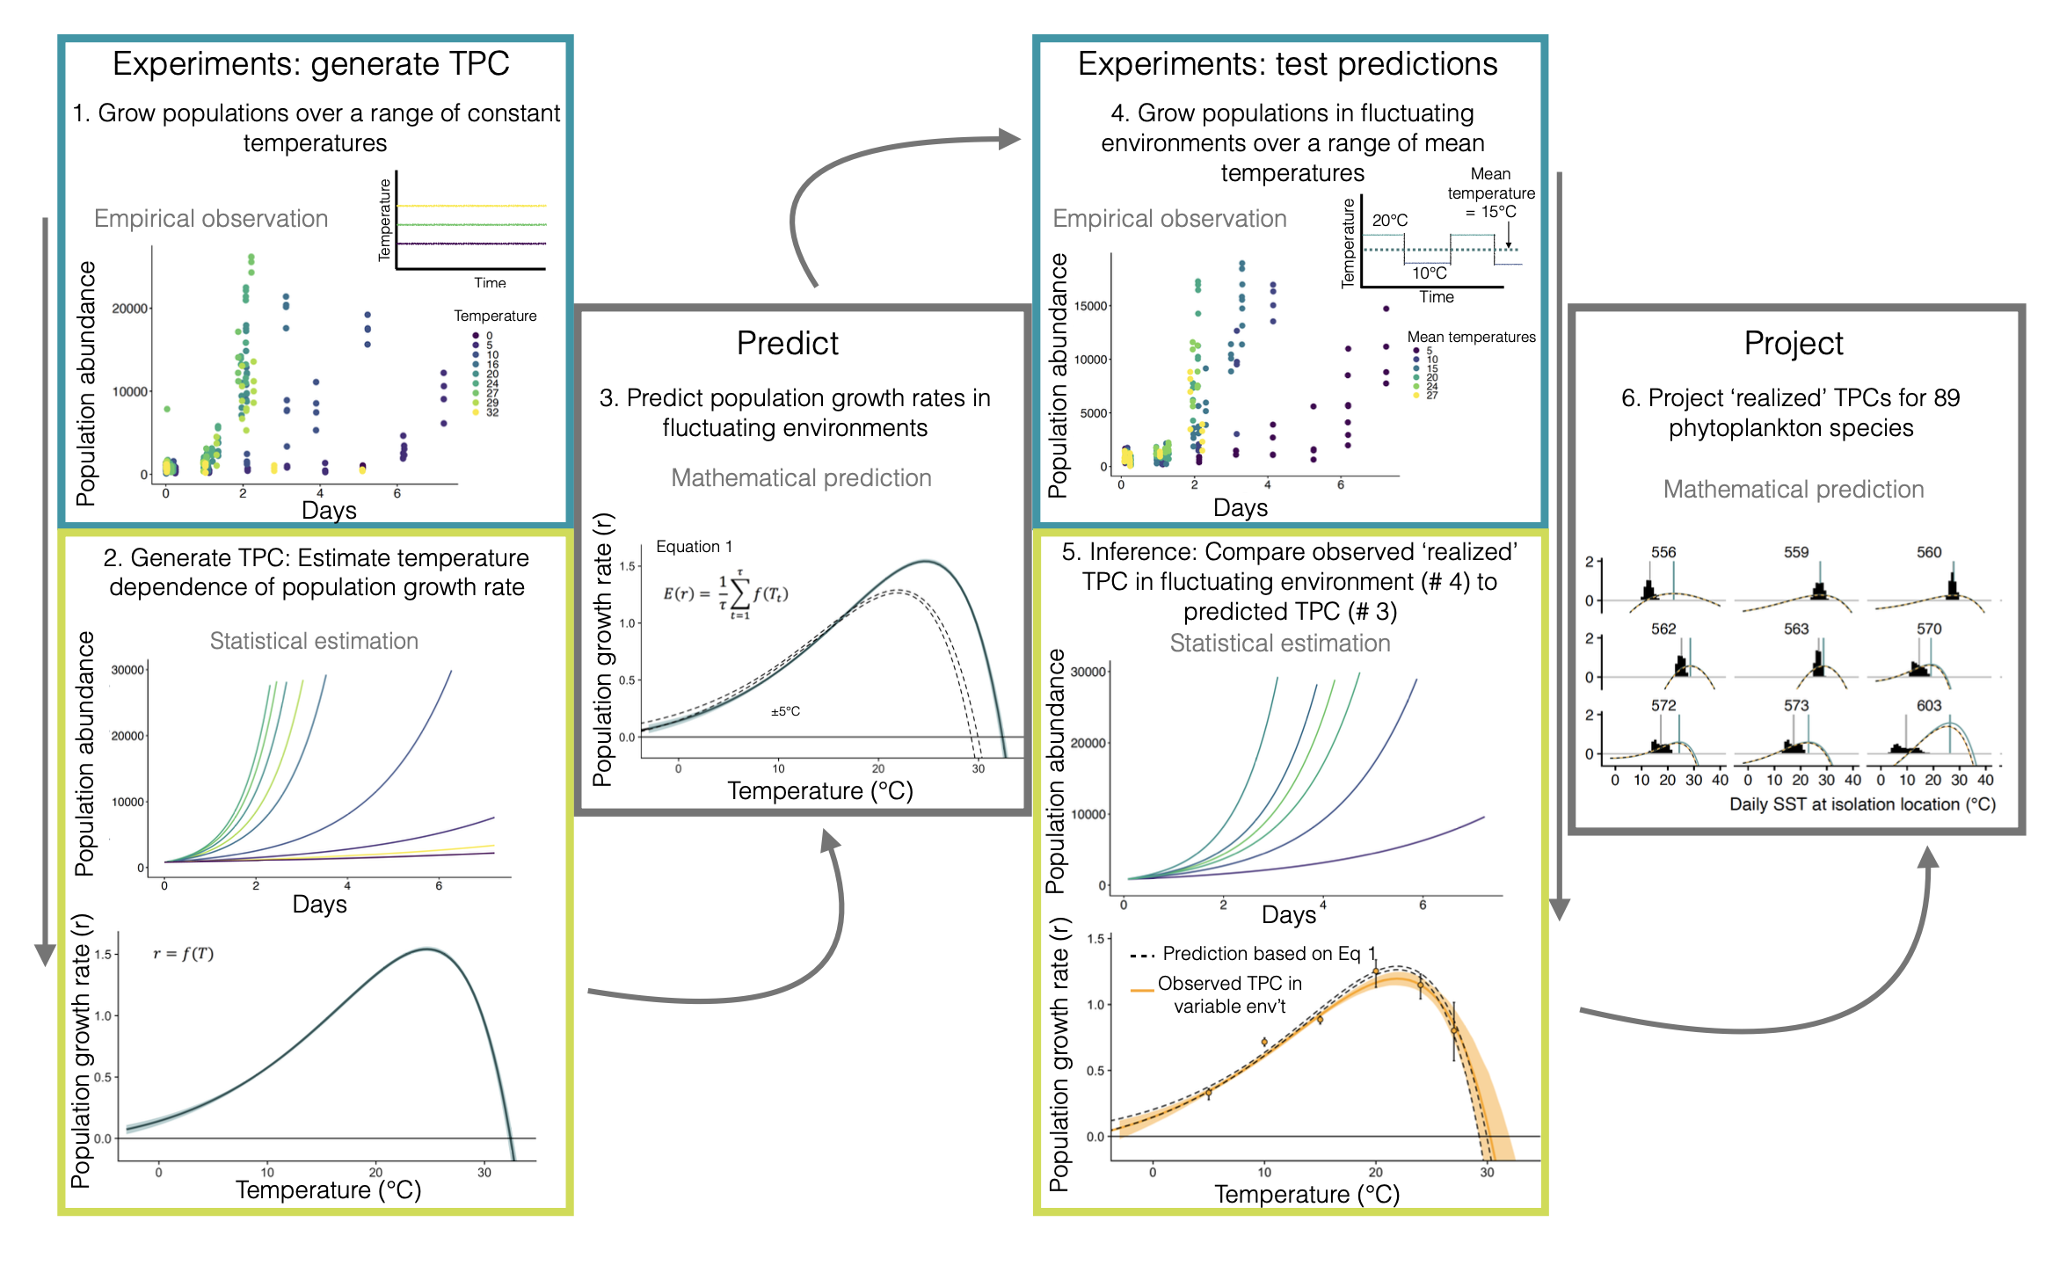
Fig. S1

Slide 25
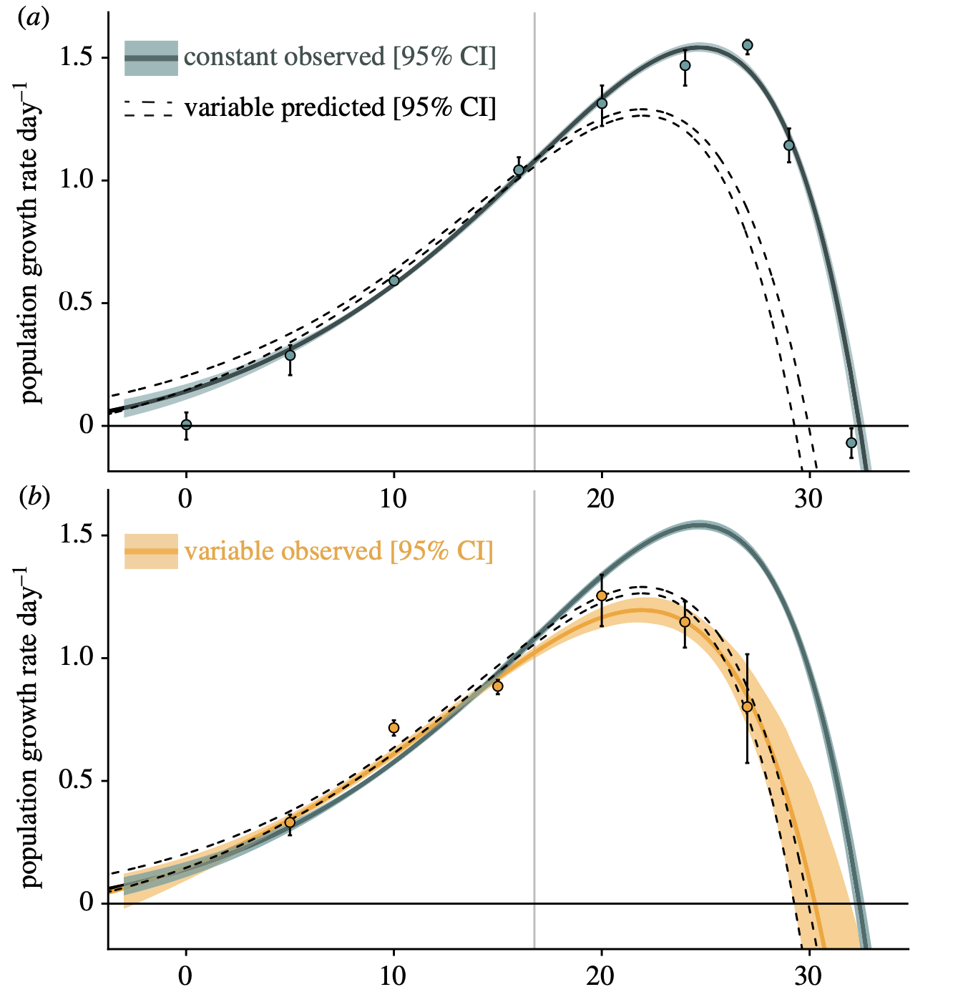
Fig. 2

Slide 26
Initial discussion questions
Any technical questions?
What are the main conclusions of the paper?
What other questions should we discuss?

Slide 27
More discussion questions
Do you think think nonlinear averaging is important to include in predictions of phytoplankton distributions?
Is this simple model enough?
What do you think of Gouhier & Pilai’s critique?

